Slide 1

Modelling with Reconfigurable Communication Interfaces
Nir Piterman
University of Gothenburg
Joint work with: Yehia Abd Alrahman, Giuseppe Perelli,
Shaun Azzopardi, Mauricio Martel

Slide 2
Modelling with Reconfigurable Communication Interfaces
Abstract:
We survey our results on a formalism to model and reason about systems with reconfigurable communication interfaces. Processes in our formalism are independent state machines communicating by exchanging messages on broadcast and multicast channels. Messages can include additional data values allowing for further design flexibility. Broadcasts can be customized to target only recipients satisfying certain conditions on their states. Processes can connect to and disconnect from multicast channels and messages can go through only once a condition on the state of all recipients (those listening to the channel) is satisfied. Dependence on the local state of senders and receivers implies that interaction interfaces are reconfigured through execution. Reconfiguration occurs both at message level and channel level.
We show that such systems can be represented and reasoned about symbolically by including existential quantification in the definition of the transition relation. The quantification allows to apply conditions imposed by senders in a way that depends on the local state of recipients. While this symbolic representation supports a global semantics and efficient analysis, it is not compositional. We match the symbolic representation with a compositional semantics through Channeled Transition Systems. When coming to consider the partial order semantics of such reconfigurable systems, we identify that additional information about interleaving needs to be included in the partial order.
On the reasoning side, we consider an extension of LTL that allows to reason about the contents of messages and the intentions of senders when setting conditions on receivers. We support modelling and analysis through model checking of a simple programming language tailored for the production of such processes.

Slide 3
Multi-agent Modelling Wishlist
Meaningful local state.
Reconfigurable channel based communication:
Decide who to talk to based on local state.
Ability to block if not ready.
More than synchronization.

Slide 4
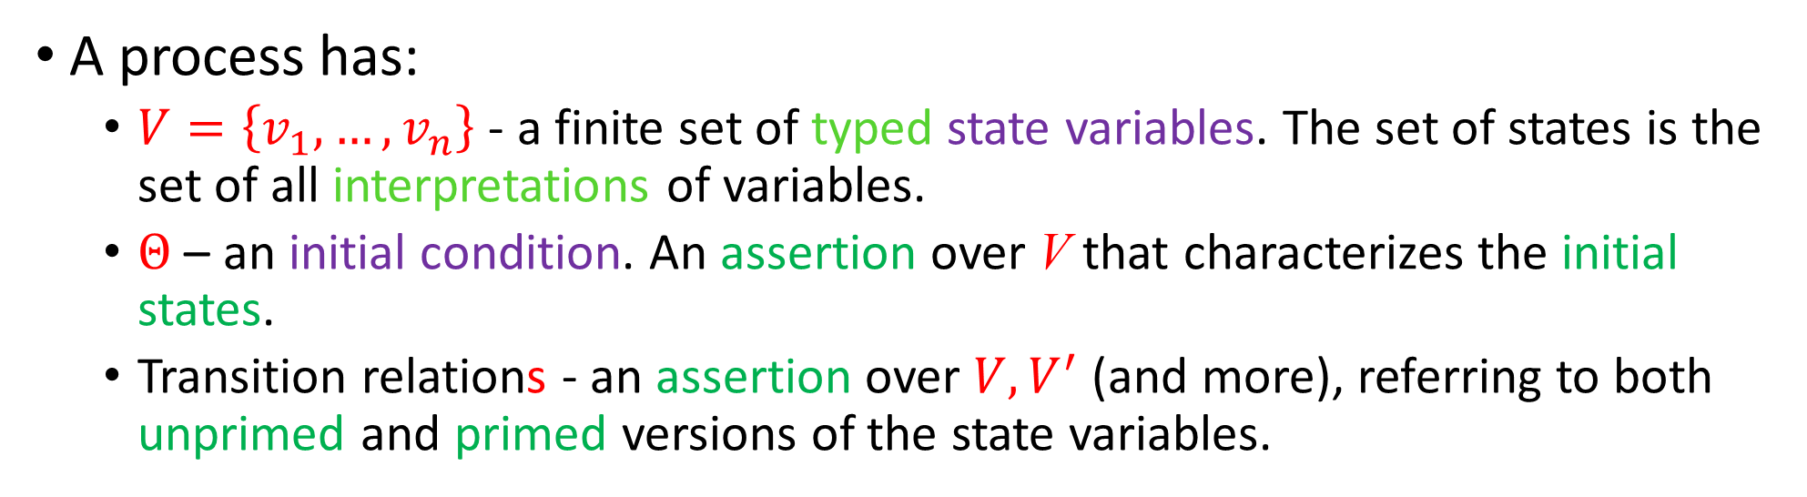
Meaningful Local State
Each agent/process has a set of local variables.
Variables range over finite domains (for decidable analysis).
Variables change on send/receive transitions.
Taken from Discrete Systems (DS)
A process has:
$V=\left\{v_{1},…, v_{n}\right\}$ - a finite set of typed state variables. The set of states is the set of all interpretations of variables.
$Θ$ – an initial condition. An assertion over V that characterizes the initial states.
Transition relations - an assertion over $V,V^{′}$ (and more), referring to both unprimed and primed versions of the state variables.

Slide 5
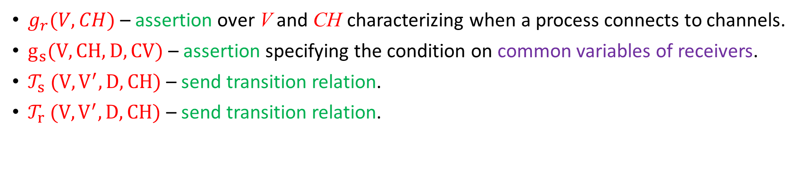
Reconfigurable Channel Based Communication
Distinguish between (non-blocking) broadcast and (blocking) multicast.
Agents connect/disconnect from multicast channels depending on state.
Send and receive transition relations.
Common variables – all processes interpret common variables over their own state variables.
Messages are sent on a channel, carry data, and predicated on common variables (of receivers).
Add to FDS
$g_{r}(V,CH)$ – assertion over V and CH characterizing when a process connects to channels.
$g_{s}(V,CH, D,CV)$ – assertion specifying the condition on common variables of receivers.
${\text{𝒯}}_{s} (V,V^{′}, D,CH)$ – send transition relation.
${\text{𝒯}}_{r} (V,V^{′}, D,CH)$ – send transition relation.

Slide 6
Parallel Composition
One sender chooses a message (channel, data, predicate):
On broadcast channel: listeners not satisfying the send guard drop the message.
On multicast channel: all listeners to the channel must satisfy the send guard (blocking).
Symbolic transition relation adds existential quantification to conjunctions to interpret common variables on receivers.

Slide 7
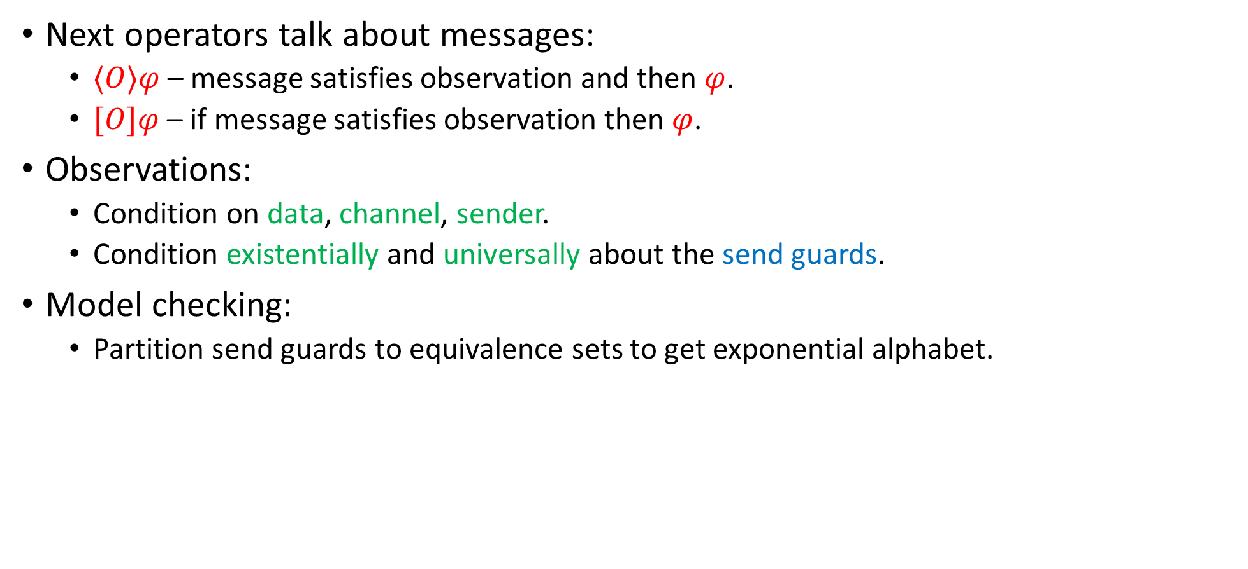
Linear Temporal Logic
Next operators talk about messages:
$⟨O⟩φ$ – message satisfies observation and then $φ$.
$[O]φ$ – if message satisfies observation then $φ$.
Observations:
Condition on data, channel, sender.
Condition existentially and universally about the send guards.
Model checking:
Partition send guards to equivalence sets to get exponential alphabet.

Slide 8
Ongoing / Future Work
Tool support:
Process-algebra-like programming language.
Translate to nuXMV.
Partial Order computations and reasoning about them.
Reconfiguration adds another dimension of nondeterminism.
Games and reactive synthesis.

Slide 9
